Slide 1
NGs nye innloggings-side
1-2-3 User Guide
Alt på ett sted. Følg med!

Slide 2
NANO – new login service in NorgesGruppen
NorgesGruppen is now releasing a new login service "NANO" for NG applications.
NANO will also replace today's reset password service.
During the spring an active NANO account will be necessary to log in to NG applications.
Therefore start the onboarding/activation process today.
Activation link for NANO will be received through SMS or email

Slide 3
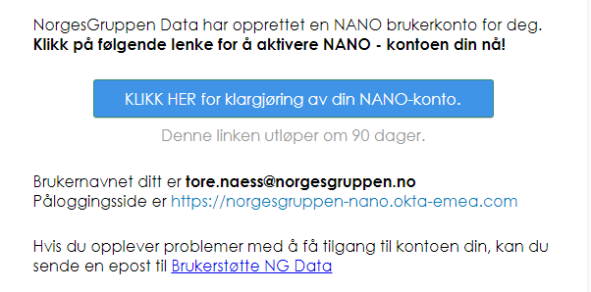
Search for «Velkommen til ny innloggingstjeneste» in your email innboks
The link will lead you to activation of your NANO account
Open email
Press the blue activation button in the mail to start activation. NB! You must have your mobile phone available.

Slide 4
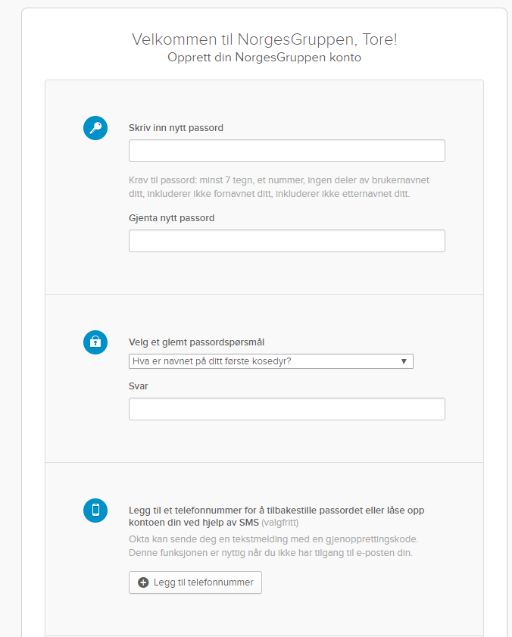
1: Get ready
Choose a new and unique password
Forgot password question
Type your cell phone number
Bla om

Slide 5
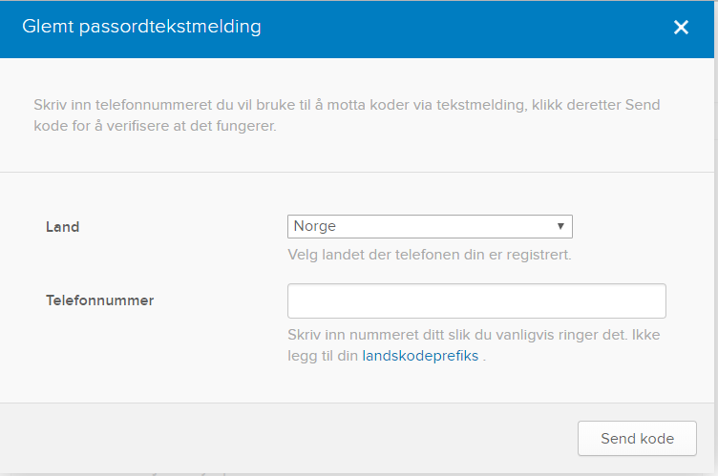
2: Cell phone setup for forgotten password
Country
Cell phone number
Click «Send kode»

Slide 6
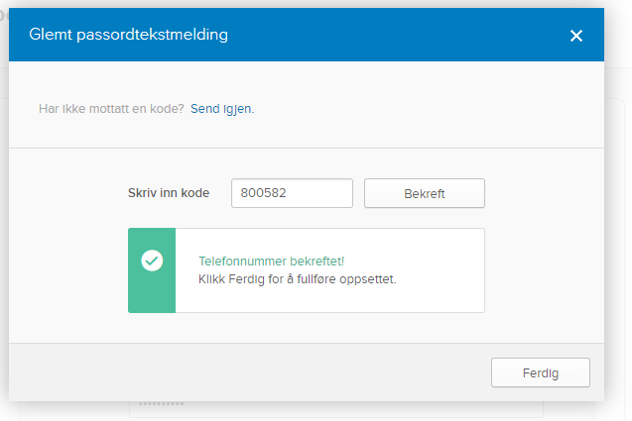
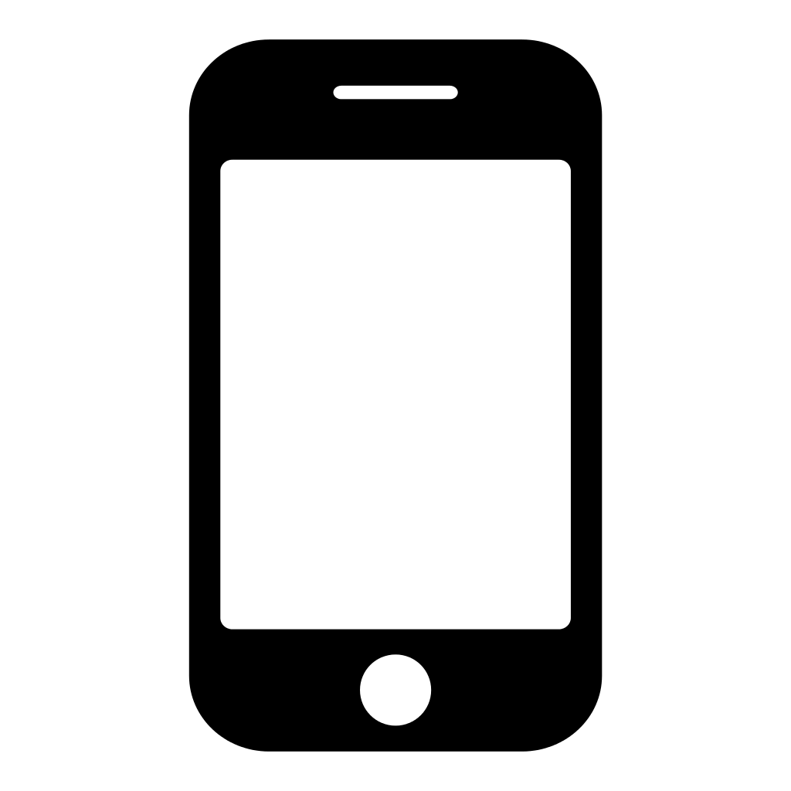
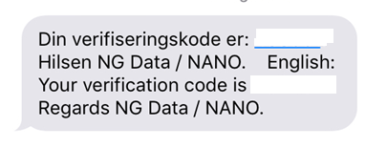
3: Set up
Control cell phone:
Type code Click Bekreft.
Click Ferdig
Scroll down and click Opprett min konto

Slide 7
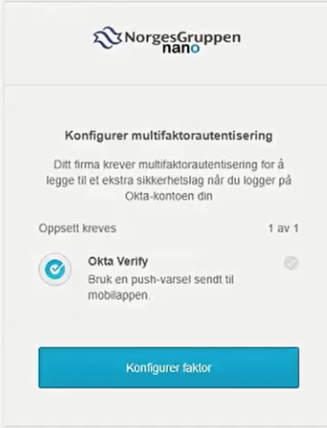
STEP 4: Setup 2-factor (MFA*)
Click Konfigurer faktor
*MFA (Mulifaktorautentisering)

Slide 8
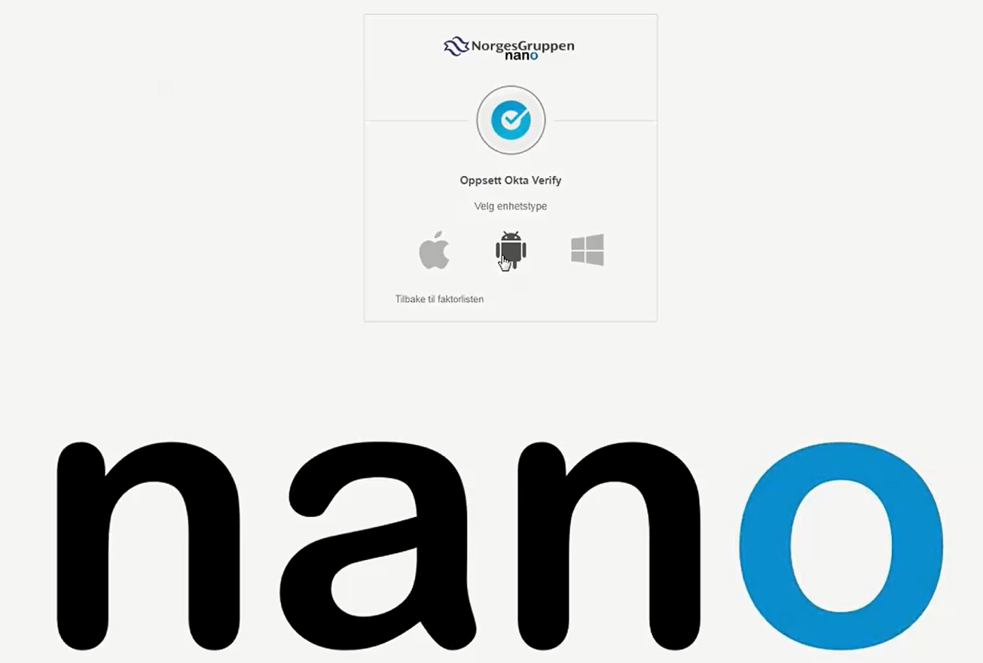
STEP 4.1: Choose cell phone type
Windows user
iPhone user
Android user (Samsung, HTC f.eks.) trykk her

Slide 9
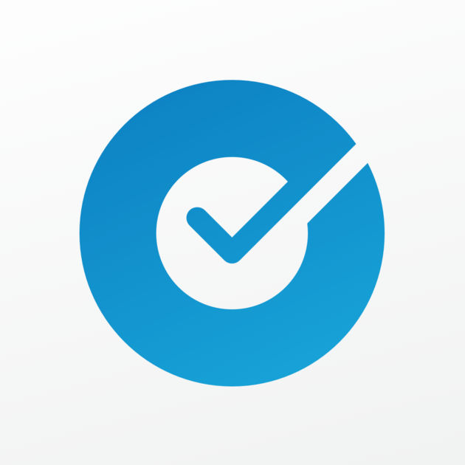
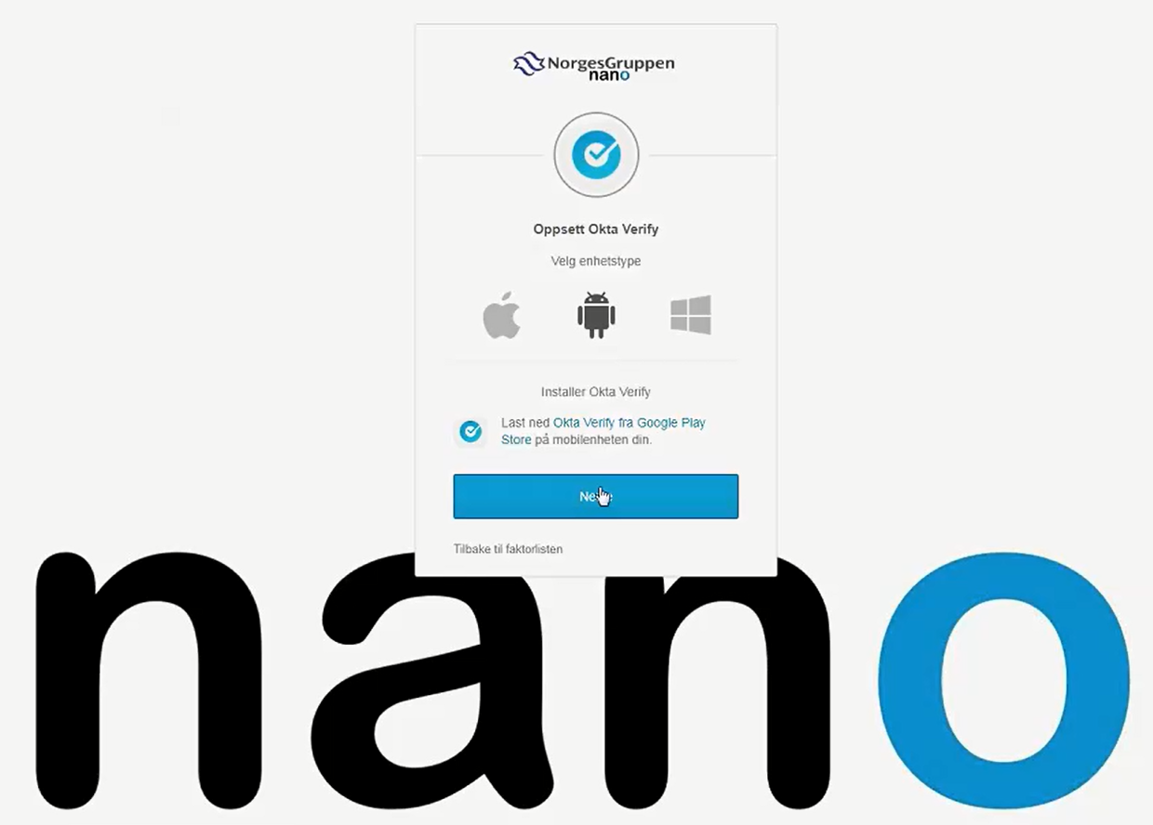
STEP 4.2: Download Okta Verify
Download app’en “Okta Verify” fra AppStore / Google Play on your cellphone
Click Neste on your Laptop

Slide 10
STEP 4.3: Open Okta Verify - appen
Open app on cellphonen:
Click Add Account
Choose «Scan Code to add your account»

Slide 11
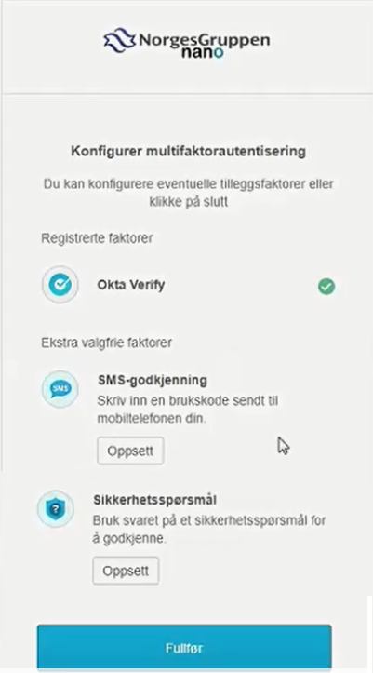
5: Klargjør flere 2-faktor (sikkerhetsløsning)
«SMS-godkjenning» og «Sikkerhetsspørsmål» are volunteer

Slide 12
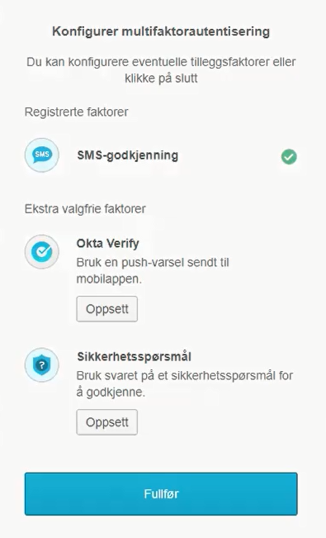
Click Fullfør
Activating Nano-account is now complete

Slide 13
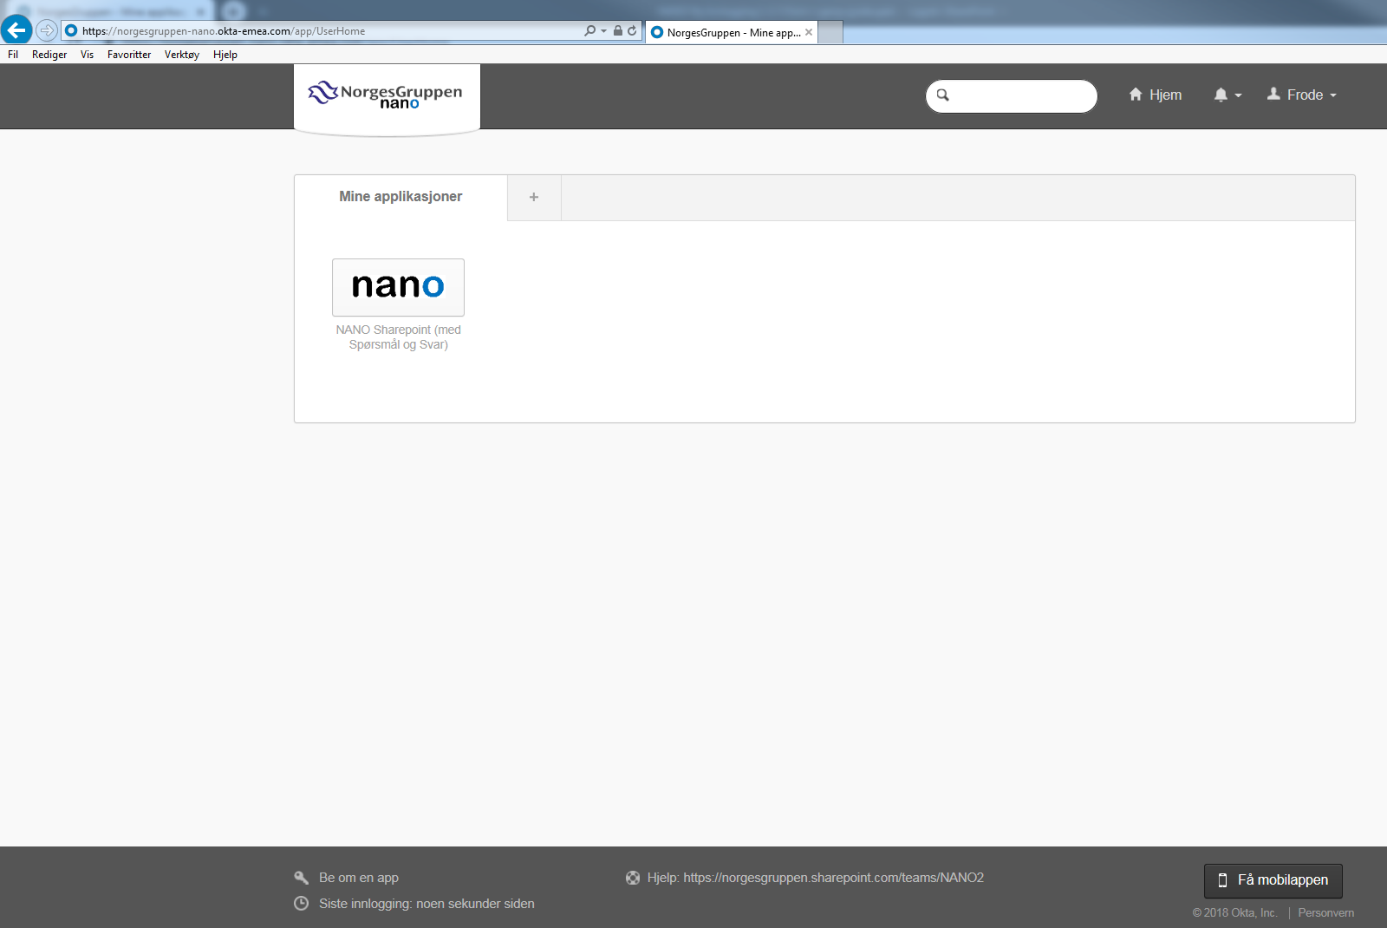
You are now logged on.
Soon some apps will appear on this page.

